Slide 1
Technology based prevention of Cartelization in APMC
Uday Kumar Vusirikapally
192CS028
M. Tech , NITK

Slide 2
Contents
What is a Cartel
What is an APMC
Workflow in APMC
Cartel in APMC
Problem Statement
Objectives
Work done
Implementation
Work to be done

Slide 3

What is a Cartel
A Cartel is a group of independent competitive market participants under the same sphere of business who collude with each other in order to improve their profits and dominate the market.

Slide 4
What is an APMC
APMC stands for Agriculture Produce Market Committee.
It is a marketing board governed by the state government to ensure farmers are safeguarded from exploitation by large retailers, as well as ensuring the farm to retail price spread does not reach excessively high levels.
Stake holders : Farmers, traders, commission agents, Local bodies, Labourers.

Slide 5
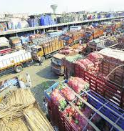
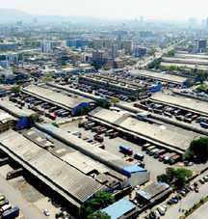

Slide 6
Workflow in APMC
Inbound Logistics
Cleaning, Sorting and Display
Auction
Outbound Logistics
Bagging, Weighting and Payments

Slide 7
Cartel in APMC
Normal flow :
Commision agent takes care of cleaning, sorting and display of the farmers produce
Auctioneer starts the auction
Traders whoever interested raise their bids and buy the produce
Cartelization in APMC
Traders gather around in advance and comes to an agreement to buy the produce for a price fixed by them which leads to no competition in the bids

Slide 8
Problem statement
Need to detect cartels
Cartel Impact on farmers
Cartel Impact on competitors

Slide 9
Objectives
Study working of APMC
Study Cartel system in APMC
Find or create a dataset
Propose methods to detect Cartels in APMC
Write an algorithm that can detect cartel
Implement the algorithm and test it
Develop a demo web application that can simulate the auction and provide results

Slide 10
Work done
Studied the working of APMC
Studied Cartel system
Proposed basic version of the methods to detect cartels

Slide 11
Method 1 based on profit share in cartel
Traders collude to get collective profit
Find the list (L1) of traders who get nearly equal profits on a periodic basis for a product X
Collect the list (L2) of traders who won the auctions of product X w.r.t time
Look if entire L1 or subset of L1 follows a winning pattern in L2

Slide 12
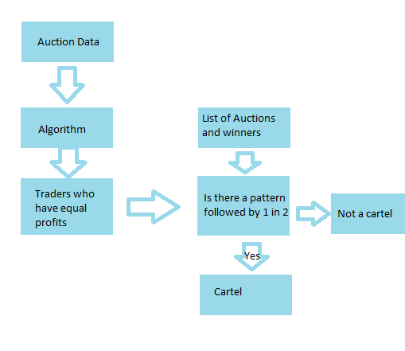

Slide 13
Example
Auction ID | Product type | Trader ID | Bid | Quantity | Retail Price
Traders participating : A,B,C,D,E
Traders with nearly equal profit : A,B,C,E
Winning Pattern : D,A,E,B,C,A,B,C,E,A,D,B,C
Cartel : ABC

Slide 14
Method 2 based on trust point for trader
Assign trust point for all traders
Categorize the products into less vulnerable to cartel and more vulnerable to cartel
Increment or decrement trust point of trader based on his/her actions in APMC
Set a threshold point to categorize a trader to be part of cartel

Slide 15
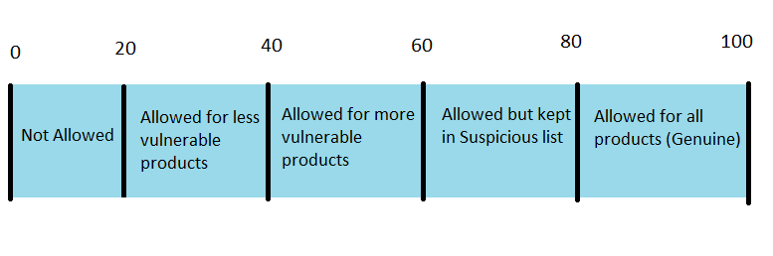
Trust point scale

Slide 16
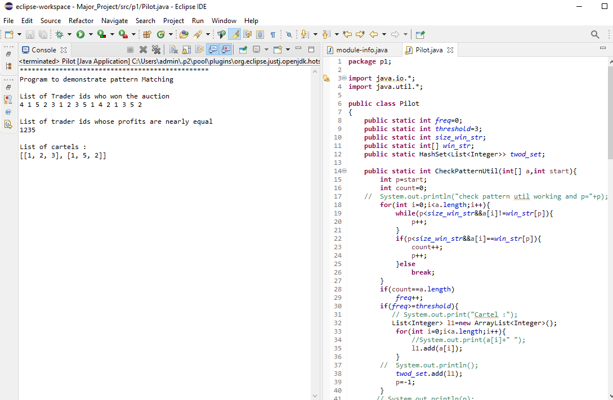
Implementation screenshots

Slide 17
Work to be done
Define standard factors that alter the trust points
Provide solid reasons how such factors contribute in defining the trust point
Write the algorithm based on the chosen factors
Implement the algorithm and test it
Develop demo web application to simulate the work done

Slide 18
References
Wachs, J., Kertész, J. A network approach to cartel detection in public auction markets. Sci Rep 9, 10818 (2019). https://www.nature.com/articles/s41598-019-47198-1
Bence Tóth1 , Mihály Fazekas2 , Ágnes Czibik3 , István János Tóth4 Toolkit for detecting collusive bidding in public procurement http://www.govtransparency.eu/wp-content/uploads/2015/11/GTI_WP2014_2_Toth_et_al_150413.pdf
OECD. Ex officio cartel investigations and the use of screens to detect cartels. 2013.
Robert H. Porter and J. Douglas Zona. Detection of bid rigging in procurementauctions.Journal of Political Economy, 101(3):518–538, 1993. doi: 10.1086/261885.URLhttps://doi.org/10.1086/261885.

